Slide 1

My Linear Relationships Interactive Notebook
Name:
Class:
Teacher:
Semester 2
Term 4
1

Slide 2

Interactive Notebooks!
Cover Page
Contents Page
Glossary
24/7/30
EQ
Questions
Notes
Summaries
Work page
Presentation!!!
Your book, your responsibility!

Slide 3
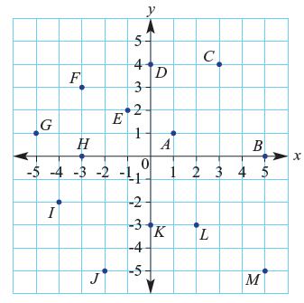
revision
Write the coordinates:
A:
C:
E:
H:
I:
K:
M:
Notes:
Give them time to write what they know on the left hand side.
How you get the info off them is up to you, TPS, popcorn etc.

Slide 4
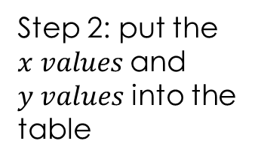
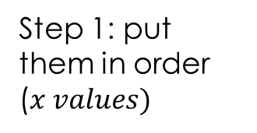
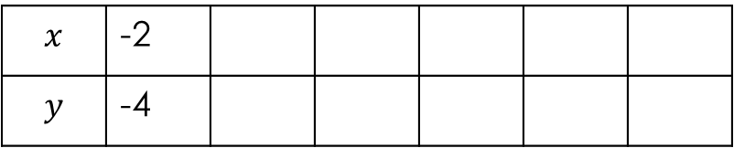
24
7
30
Topic: Linear Relationships
Date
EQ – How do you draw a graph from a table?
How do we put coordinates in a table?
Coordinates can also be written in a table to organise them and make them easier to graph.
Step 1: put them in order ($x values)$
Step 2: put the $x values$and $y values$ into the table
Consider the following set of coordinates:
(0, -2) (3, 1) -1, -3)
(1, -1) -2, -4) (2, 0)
Consider the following set of coordinates:
(0, -2) (3, 1) (-1, -3)
(1, -1) (-2, -4) (2, 0)
(-2, -4) (-1, -3) (0, -2) (1, -1) (2, 0) (3, 1)
-1
-3
0
-2
$$x$$ | -2
$$y$$ | -4

Slide 5
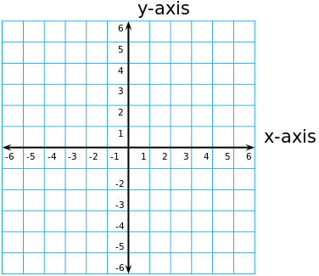
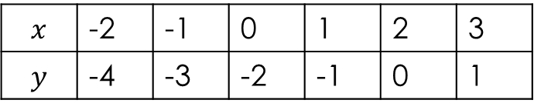
24
7
30
Topic: Linear Relationships
Date
EQ – How do you draw a graph from a table?
How do we graph points from a table?
$$x$$ | -2 | -1 | 0 | 1 | 2 | 3
$$y$$ | -4 | -3 | -2 | -1 | 0 | 1

Slide 6
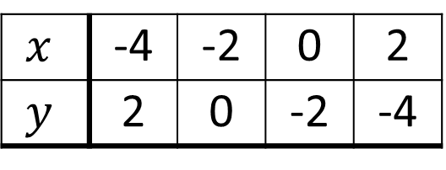
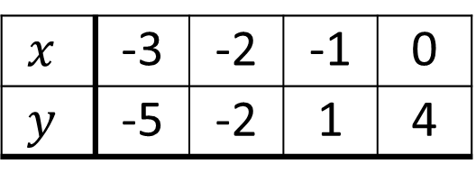
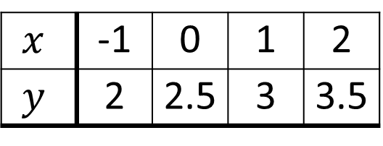
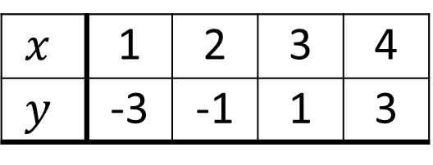
Your Turn (LHS of course)
Worksheet
(a)
$$x$$ | 1 | 2 | 3 | 4
$$y$$ | -3 | -1 | 1 | 3
(b)
$$x$$ | -1 | 0 | 1 | 2
$$y$$ | 2 | 2.5 | 3 | 3.5
(c)
$$x$$ | -3 | -2 | -1 | 0
$$y$$ | -5 | -2 | 1 | 4
(d)
$$x$$ | -4 | -2 | 0 | 2
$$y$$ | 2 | 0 | -2 | -4

Slide 7
24
7
30
Topic: Linear Relationships
Date
EQ – How do you draw a graph from a table?

Slide 8

Do you understand?
Notes:
Check for Understanding

Slide 9

Your Turn
WORKSHEETS
Left Hand Side

